Slide 1






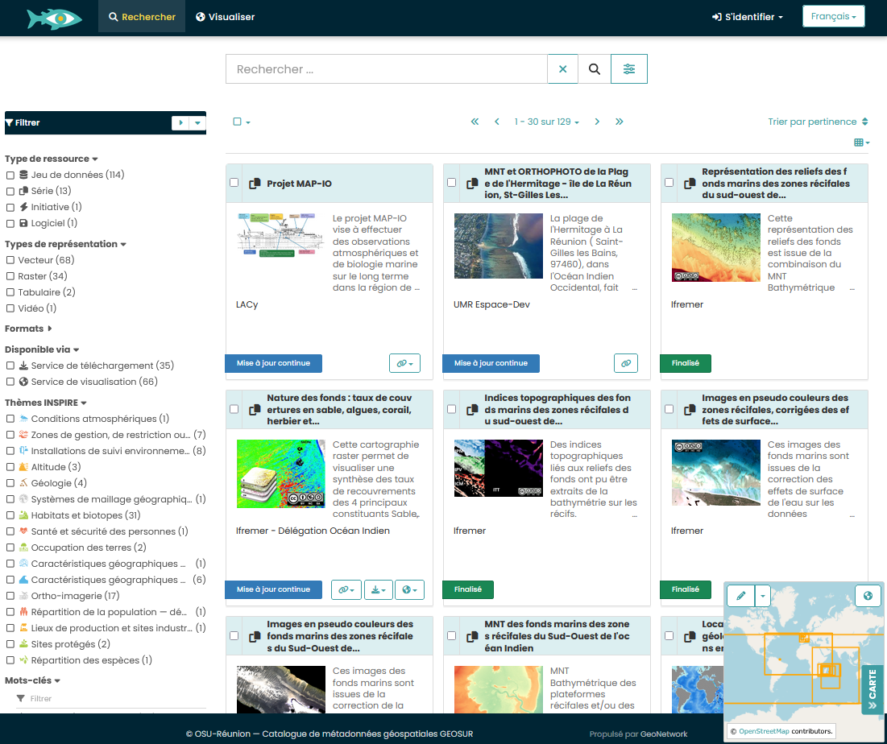
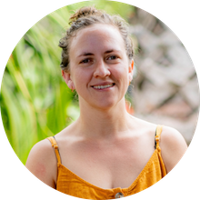

BRIDGES Data Catalog :
An interdisciplinary digital environment on coastal and marine socio-ecological systems in the southwestern Indian Ocean
Julie Furiga, Research Engineer at CNRS, within Data Terra and BRIDGES INFORMATION project
BRIDGES OCEAN TALKS#2 - 9th June 2026 - 1-1:45pm (UTC +4)

Slide 2

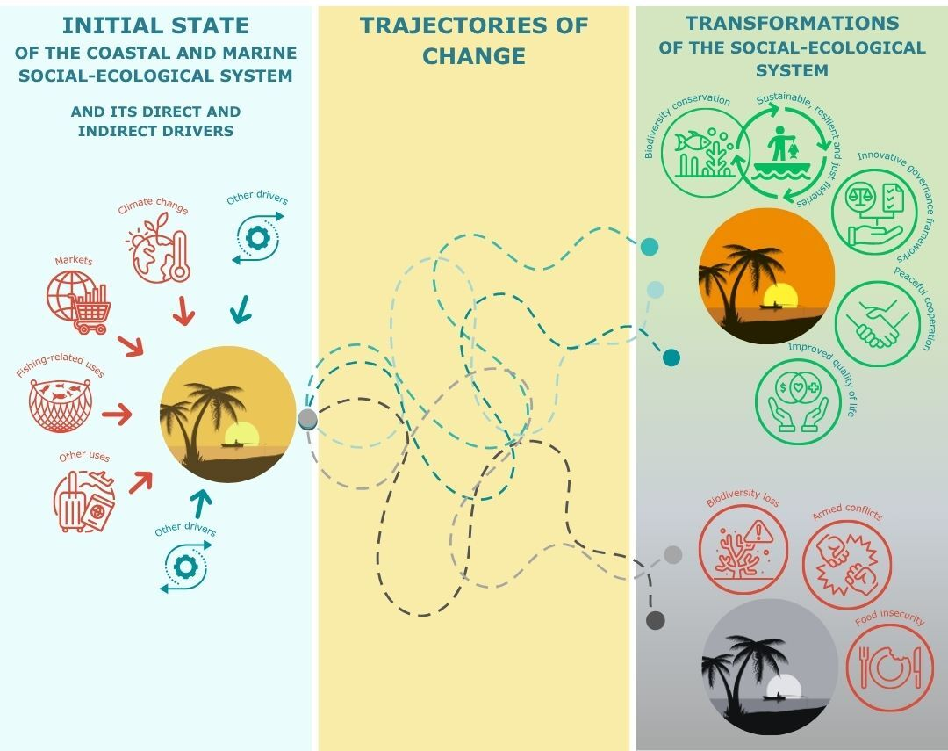

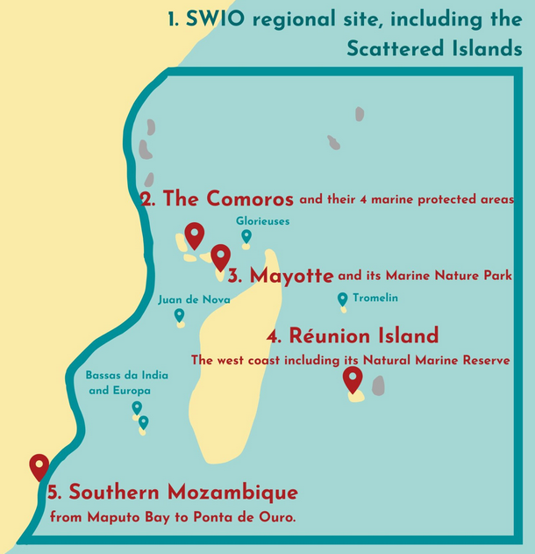
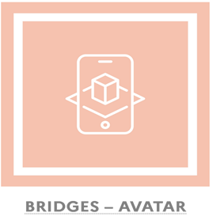

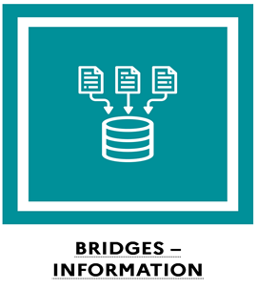

Fishing and biodiversity in the southwestern Indian Ocean
2023-2033
Facilitating the co-construction of sustainable forms of transformation
Transdisciplinary approach to the dynamics of coastal and marine SES
Development of digital avatars of local & regional SES
Innovative observatory of SES
Information system on the SWIO marine socio-ecosystems
Impact assessment of changes in marine SES
BRIDGES OCEAN TALKS#2 - 9th June 2026 - 1-1:45pm (UTC +4)
Notes:
•Biodiversité et pêche artisanale au cœur des modes de vie et de consommation de nombreuses communautés (source nutritionnelle, revenus, etc.)
•Pressions globales (changement climatique, demande en ressources naturelles croissante, intensification des usages) menacent les écosystèmes et les sociétés humaines qui en dépendent
•Renforcer la résilience sociale et environnementale grâce à un ambitieux travail de recherche collaborative, et à soutenir une future génération de chercheurs et d’acteurs pour la région
APPUYER LES TRANSFORMATIONS AVEC LA RECHERCHE SCIENTIFIQUE
•Identifier des solutions garantissant la conservation de la biodiversité et une pêche juste et durable
•Comment améliorer la gouvernance des systèmes de pêche ?
•Proposer des outils de gestion spatialisée

Slide 3
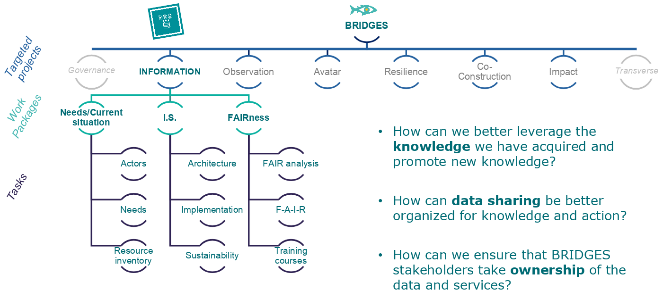
BRIDGES OCEAN TALKS#2 - 9th June 2026 - 1-1:45pm (UTC +4)
Notes:
OBJECTIFS :
Définir et mettre en œuvre un environnement numérique interdisciplinaire sur les systèmes socio-écologiques côtiers et marins du sud-ouest de l’Océan Indien
•Comment mieux exploiter les connaissances acquises et promouvoir de nouvelles connaissances ?
•Comment mieux organiser le partage des données pour favoriser les connaissances et l’action ?
•Comment garantir que les parties prenantes de BRIDGES s’approprient les données et les services ?

Slide 4

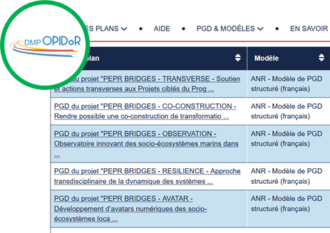
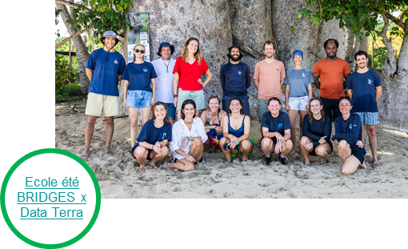
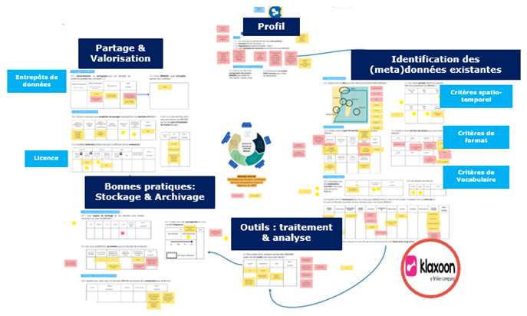
BRIDGES-INFORMATION
Understanding the scientific community’s expectations regarding digital resources
Work on the DMP
Consultation with the BRIDGES scientific community during dedicated workshops
Inclusion of BRIDGES sites in DATA training sessions:
  Réunion, Comoros, December 2025
  Mayotte, March 2026
  Mozambique, 2026
DATA Hub
Various exchanges (InterPC, fieldwork, etc.)
BRIDGES OCEAN TALKS#2 - 9th June 2026 - 1-1:45pm (UTC +4)

Slide 5
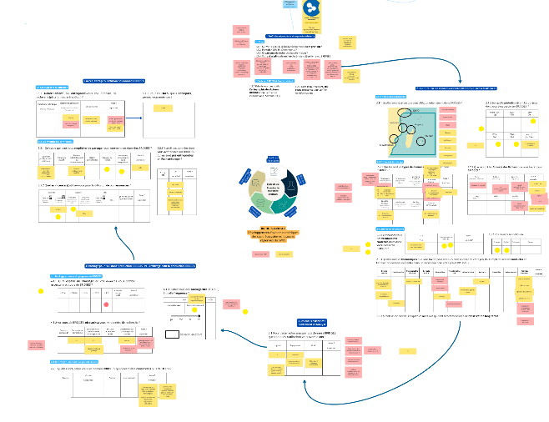




BRIDGES-INFORMATION
Understanding the scientific community’s expectations regarding digital resources
Needs
Consultation with the BRIDGES scientific community during dedicated workshops
Practices
BRIDGES OCEAN TALKS#2 - 9th June 2026 - 1-1:45pm (UTC +4)

Slide 6
BRIDGES-INFORMATION
Understanding the scientific community’s expectations regarding digital resources
Locations: not clearly defined
Time periods: starting in the 2000s
Data types: environmental and field data; models and scenarios; surveys, archives, and social data; audiovisual data; derived data, GIS, and indicators; and participatory and experimental data
File formats: tabular or databases (.csv, .xlsx), geographic (.shp, .tiff, .nc, .json), text (.pdf, .docx, .rtf, .txt), images (jpg, .jpeg, .png, .tif), and audiovisual (.mp3, .mp4, .wav), as well as model and simulation formats (.nc, .zip, Python, Java)
Languages: French, English, Portuguese, and local or regional dialects (Shikomori)
Themes: Marine biology, chemistry, physical oceanography, marine geology, atmosphere, interdisciplinarity, administration, terrestrial sciences, environment, human activities, etc.
Consultation with the BRIDGES scientific community during dedicated workshops
Needs
Practices
BRIDGES OCEAN TALKS#2 - 9th June 2026 - 1-1:45pm (UTC +4)

Slide 7
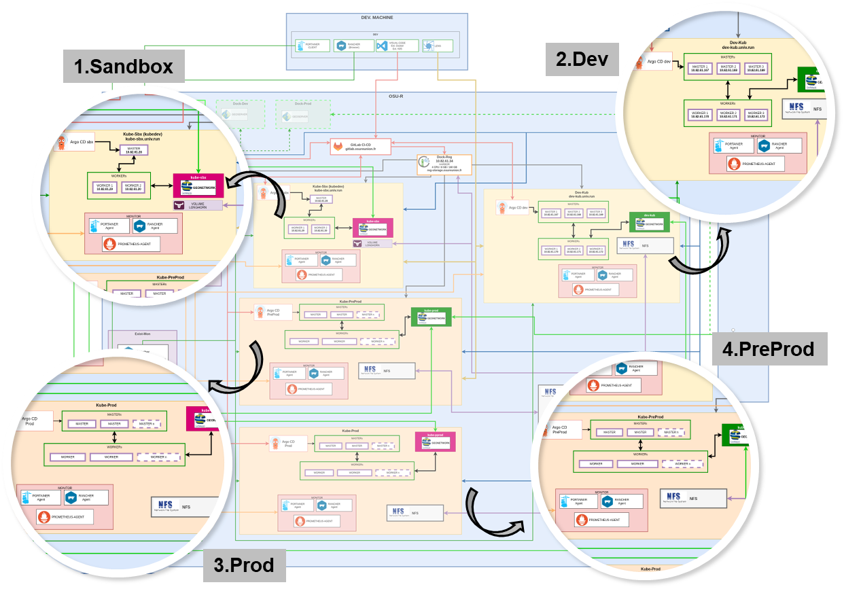

BRIDGES-INFORMATION
Building an information system: the catalog
GéoNetWork v.4.4.5
Integration of existing software components into GéOSUR
BRIDGES OCEAN TALKS#2 - 9th June 2026 - 1-1:45pm (UTC +4)

Slide 8
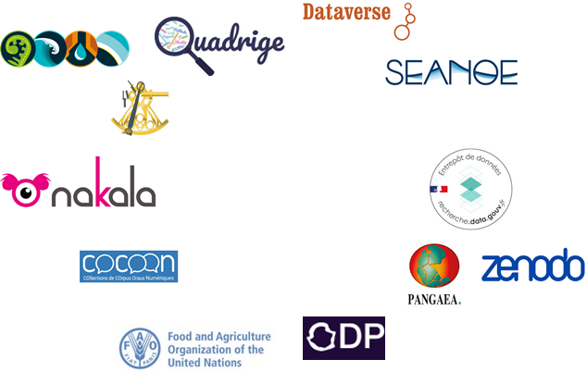
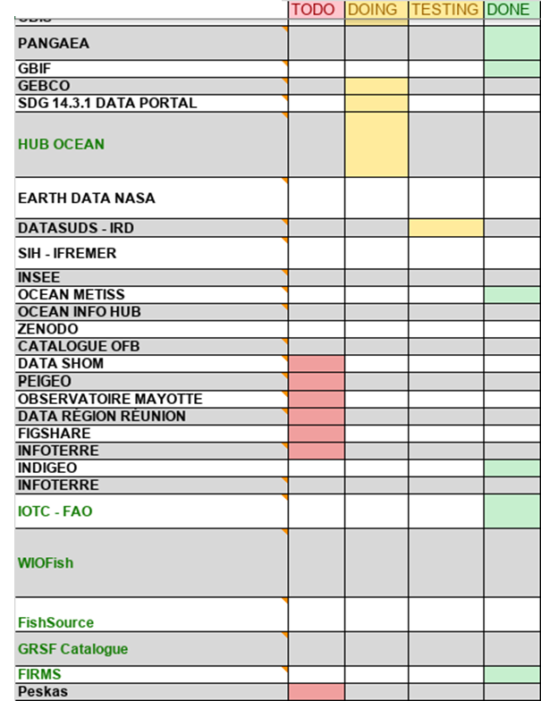
BRIDGES-INFORMATION
Linking needs to the information system
Identify repositories or catalogs containing metadata of interest to the BRIDGES scientific community
BRIDGES OCEAN TALKS#2 - 9th June 2026 - 1-1:45pm (UTC +4)

Slide 9
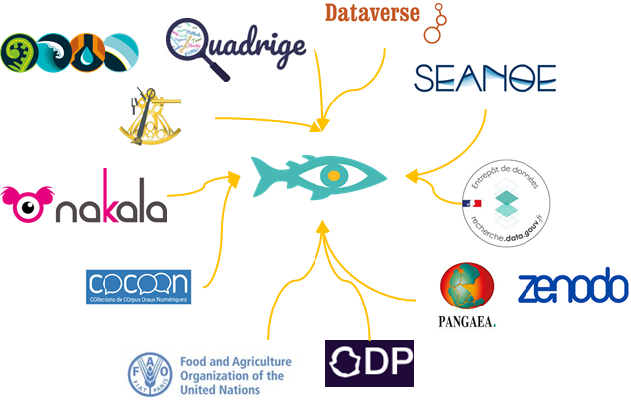
BRIDGES-INFORMATION
Linking needs to the information system
Identify repositories or catalogs containing metadata of interest to the BRIDGES scientific community
Test data harvesting using appropriate protocols
BRIDGES OCEAN TALKS#2 - 9th June 2026 - 1-1:45pm (UTC +4)

Slide 10
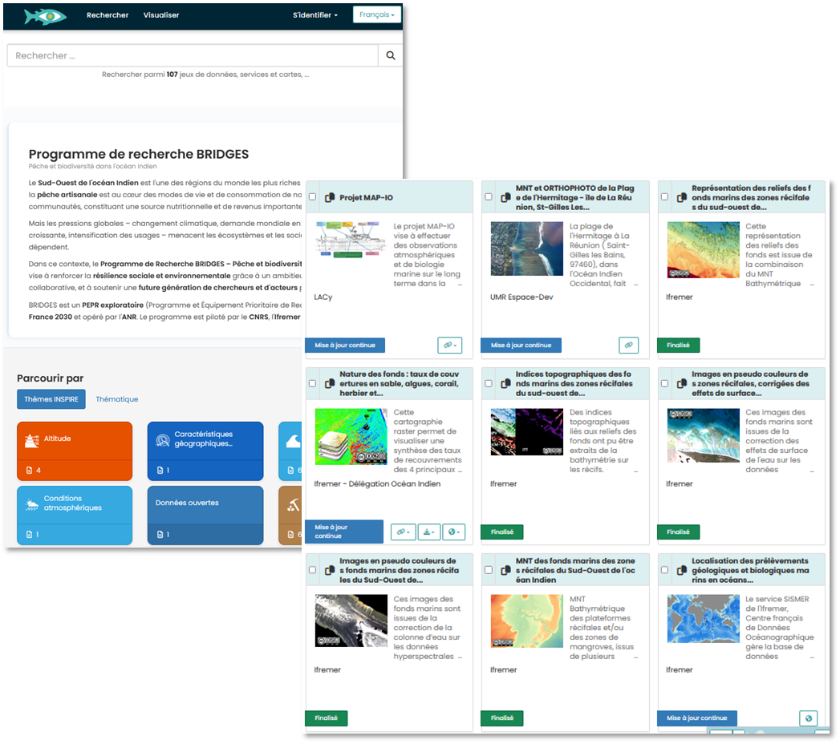

BRIDGES-INFORMATION
Linking needs to the information system
geosur.osureunion.fr/geonetwork/Bridges
accessible via
bridges-wio.com/si-en/
Identify repositories or catalogs containing metadata of interest to the BRIDGES scientific community
Test data harvesting using appropriate protocols
If feasible, harvest the desired data
BRIDGES OCEAN TALKS#2 - 9th June 2026 - 1-1:45pm (UTC +4)

Slide 11


BRIDGES-INFORMATION
BRIDGES Catalog and Upcoming Developments
Catalogs and Repositories currently available to explore in BRIDGES
FAO
GEOSUR
SEXTANT
SEANOE
ZENODO
INDIGEO
https://www.bridges-wio.com/si-en/
BRIDGES OCEAN TALKS#2 - 9th June 2026 - 1-1:45pm (UTC +4)

Slide 12
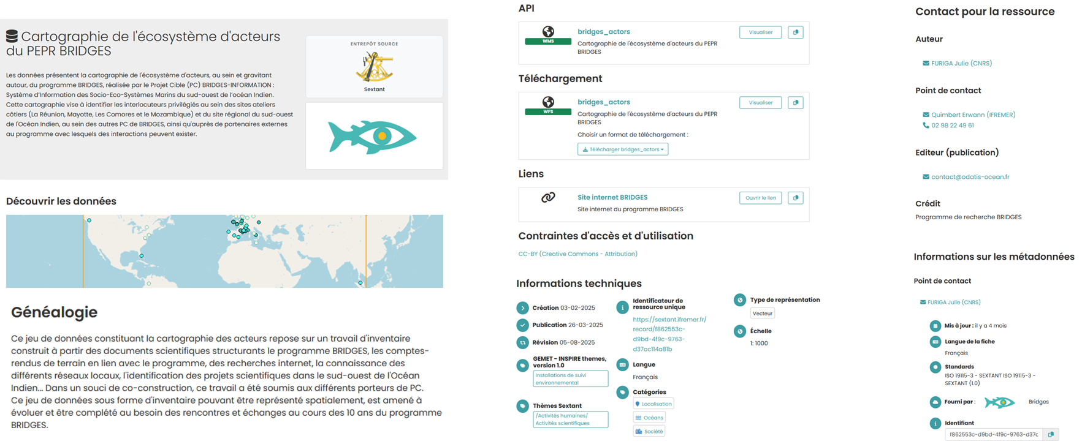
BRIDGES-INFORMATION
BRIDGES Catalog and Upcoming Developments
The information available in the metadata
BRIDGES OCEAN TALKS#2 - 9th June 2026 - 1-1:45pm (UTC +4)

Slide 13
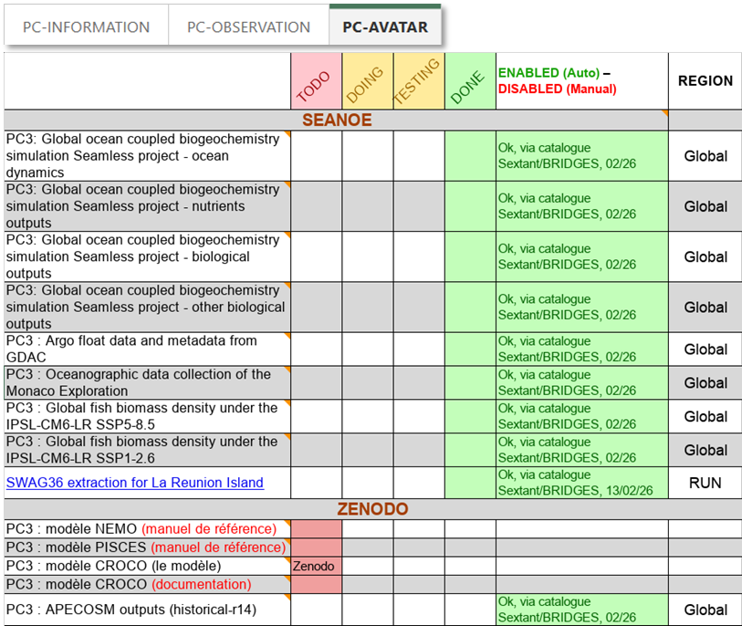
BRIDGES-INFORMATION
BRIDGES Catalog and Upcoming Developments
Upload the catalog
May 2026 = 129 records identified
Feel free to contact us if you come across any datasets: pc1_bridges@services.cnrs.fr julie.furiga@data-terra.org
BRIDGES OCEAN TALKS#2 - 9th June 2026 - 1-1:45pm (UTC +4)

Slide 14
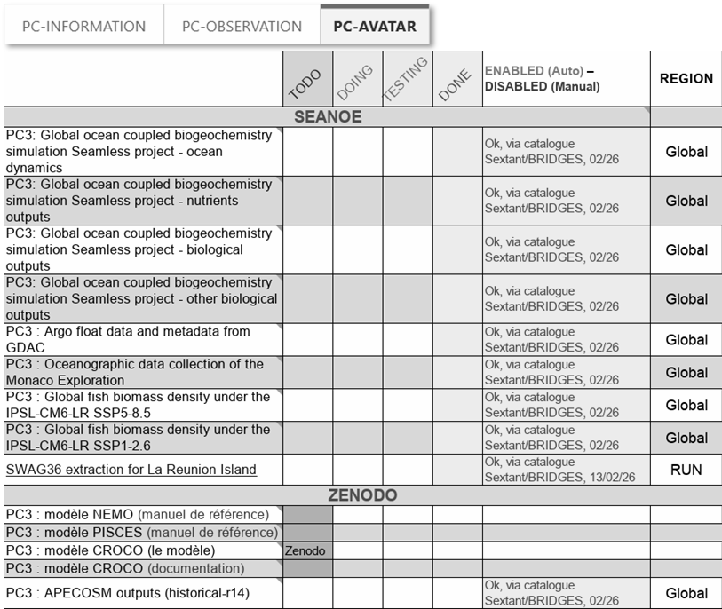
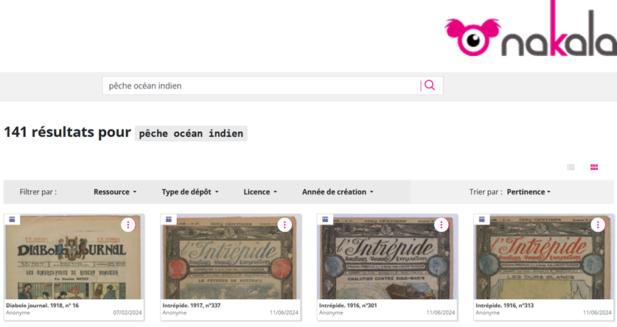
BRIDGES-INFORMATION
BRIDGES Catalog and Upcoming Developments
Upload the catalog
Working on harvesting SHS data
Work initiated in collaboration with the IR* Huma-NUM and the MSHS Bretagne to develop methods for harvesting social sciences and humanities data
Work conducted in parallel with the PEPR GFM to share best practices
Feel free to contact us if you come across any datasets: pc1_bridges@services.cnrs.fr julie.furiga@data-terra.org
BRIDGES OCEAN TALKS#2 - 9th June 2026 - 1-1:45pm (UTC +4)

Slide 15
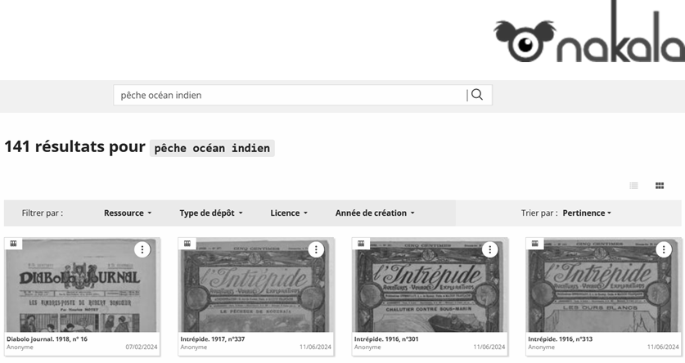
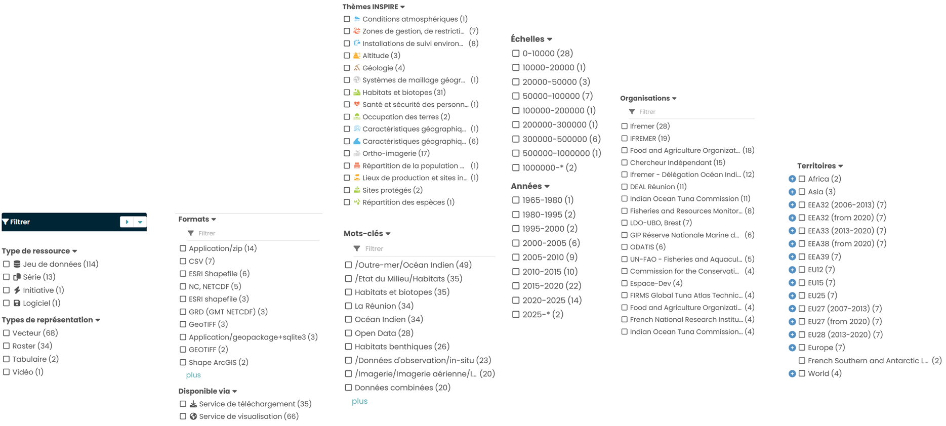
BRIDGES-INFORMATION
BRIDGES Catalog and Upcoming Developments
Upload the catalog
Working on harvesting SHS data
Work on filtering
Feel free to contact us if you come across any datasets: pc1_bridges@services.cnrs.fr julie.furiga@data-terra.org
BRIDGES OCEAN TALKS#2 - 9th June 2026 - 1-1:45pm (UTC +4)

Slide 16
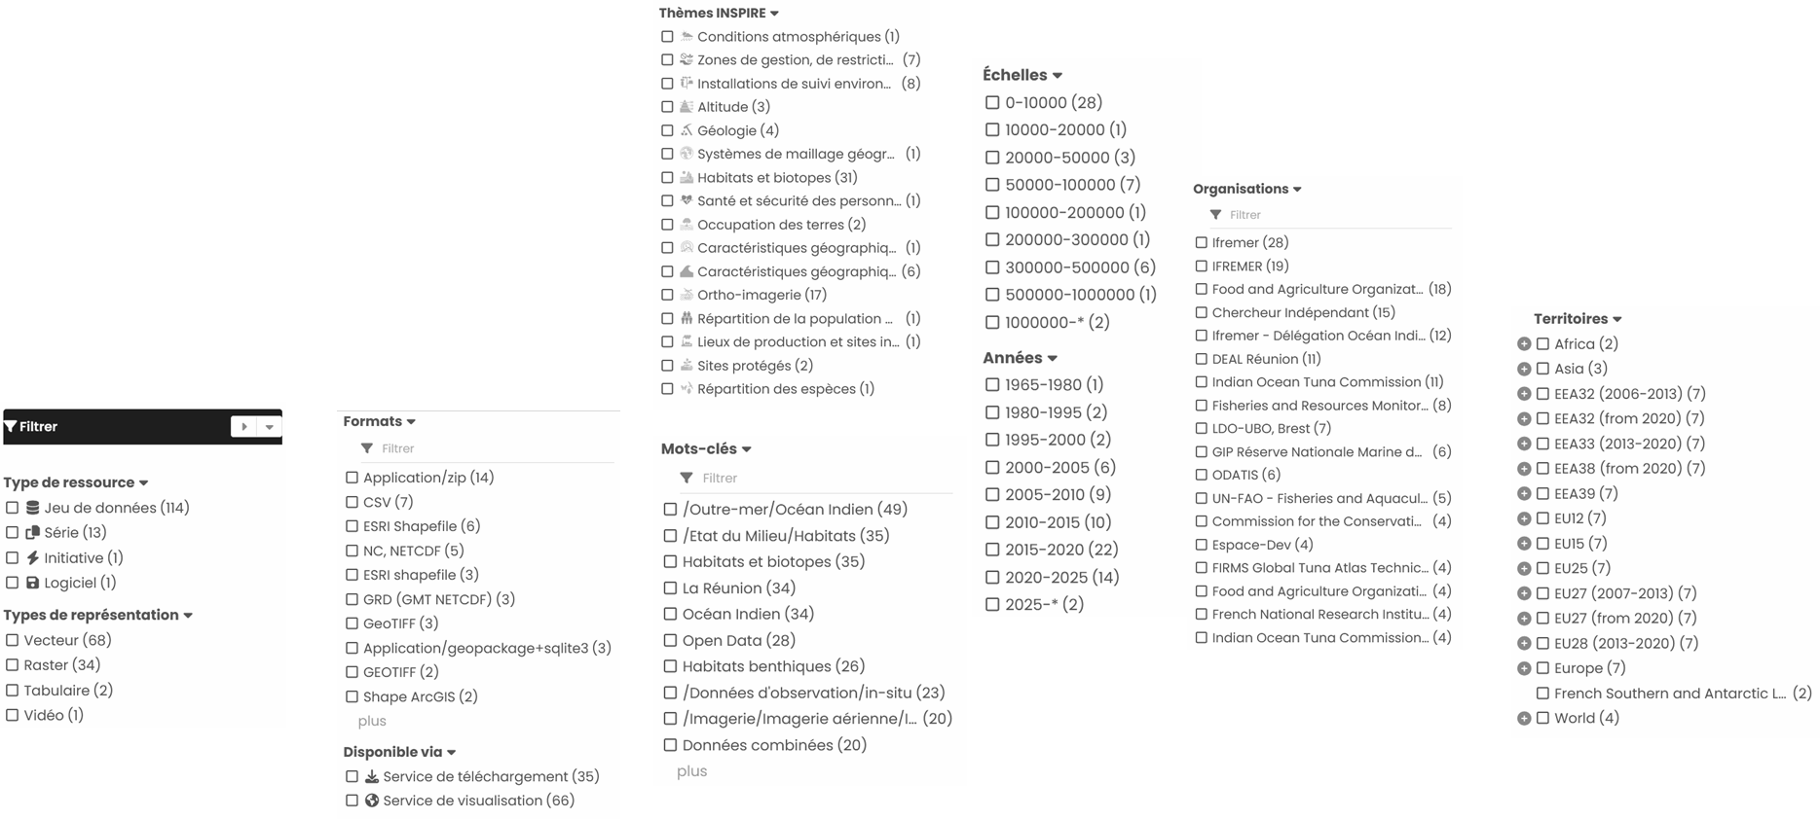
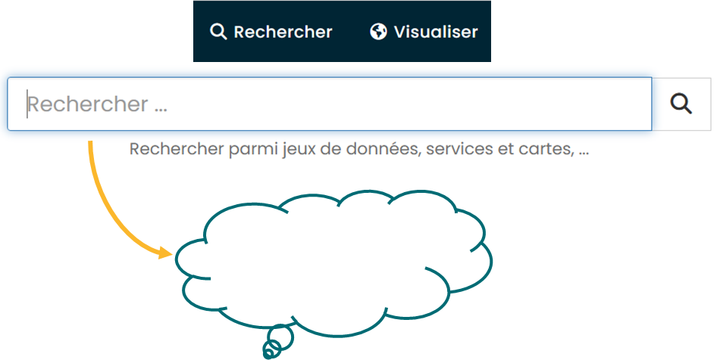
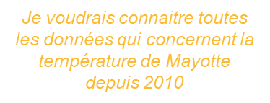
BRIDGES-INFORMATION
BRIDGES Catalog and Upcoming Developments
Upload the catalog
Working on harvesting SHS data
Work on filtering
Work on AI for data research
Feel free to contact us if you come across any datasets: pc1_bridges@services.cnrs.fr julie.furiga@data-terra.org
BRIDGES OCEAN TALKS#2 - 9th June 2026 - 1-1:45pm (UTC +4)

Slide 17
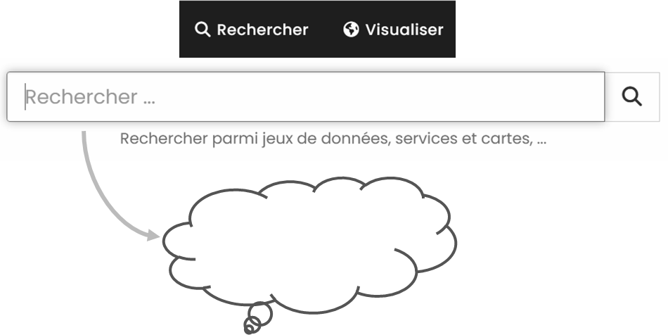
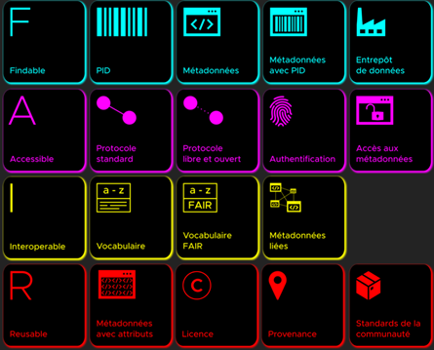
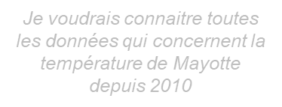
BRIDGES-INFORMATION
BRIDGES Catalog and Upcoming Developments
Upload the catalog
Working on harvesting SHS data
Work on filtering
Work on AI for data research
Supporting the FAIR principles
Feel free to contact us if you come across any datasets: pc1_bridges@services.cnrs.fr julie.furiga@data-terra.org
BRIDGES OCEAN TALKS#2 - 9th June 2026 - 1-1:45pm (UTC +4)

Slide 18
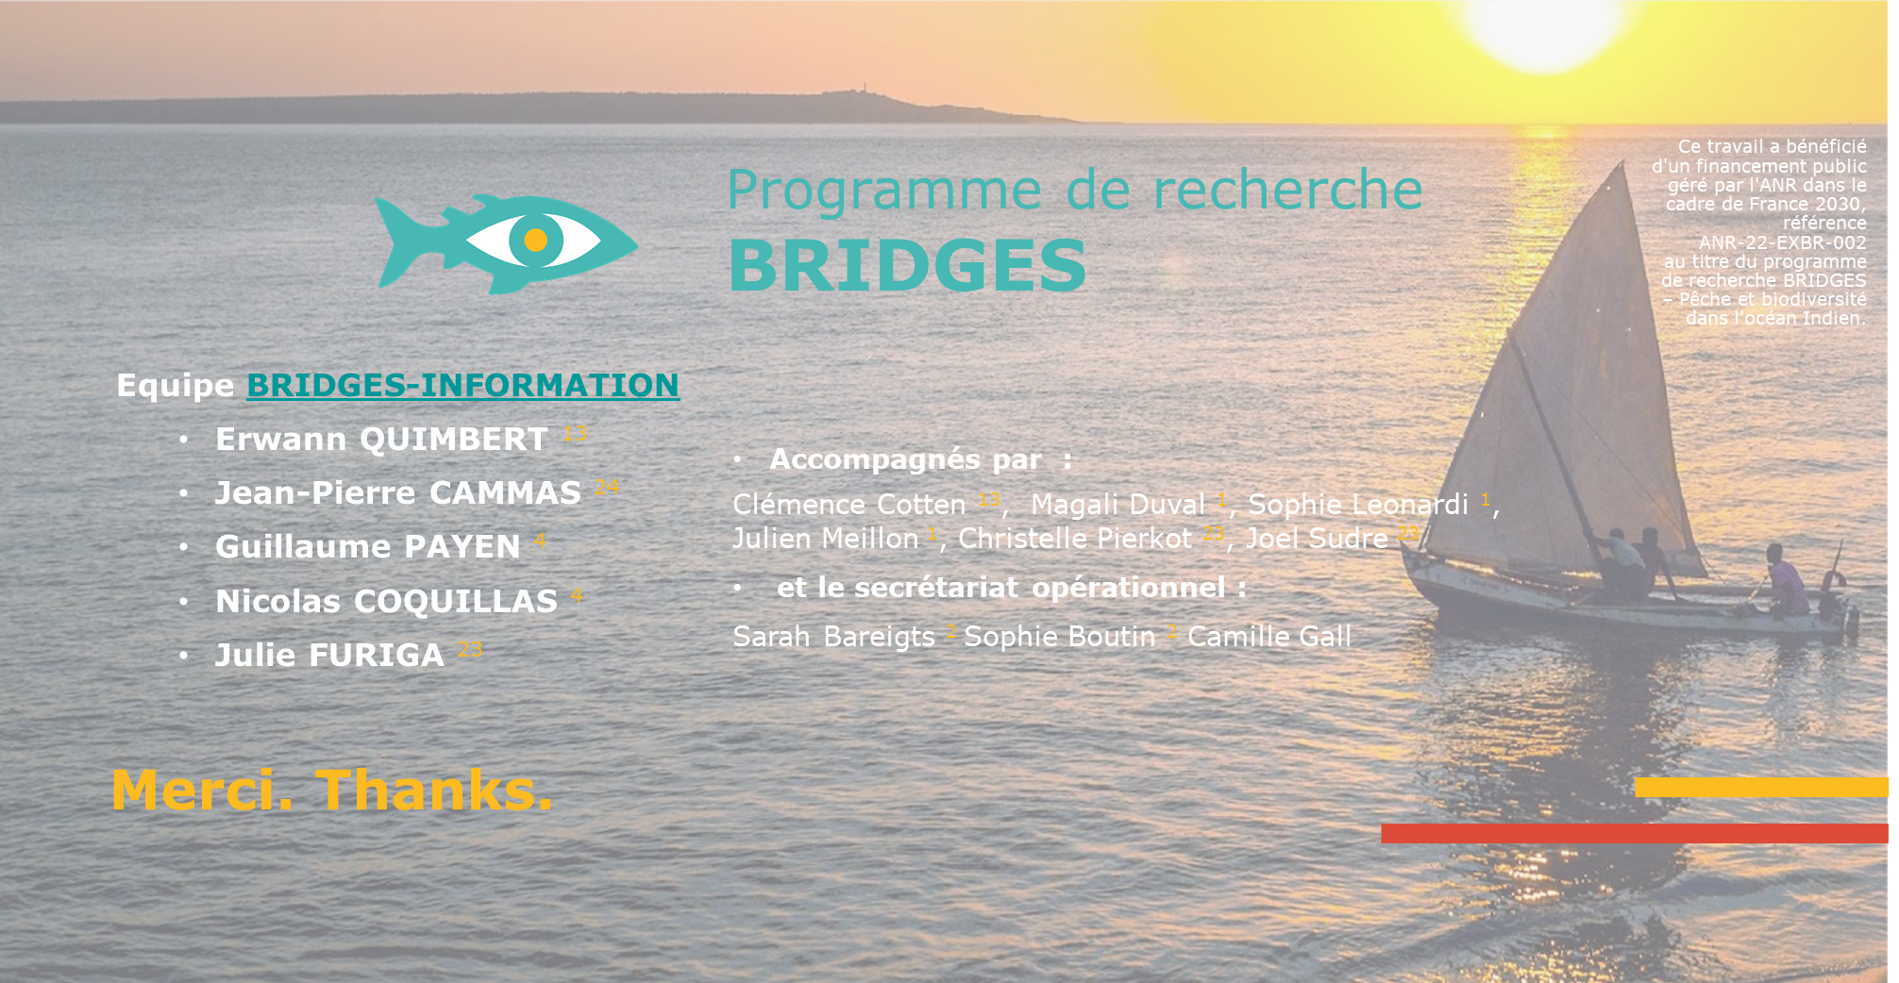

Slide 19
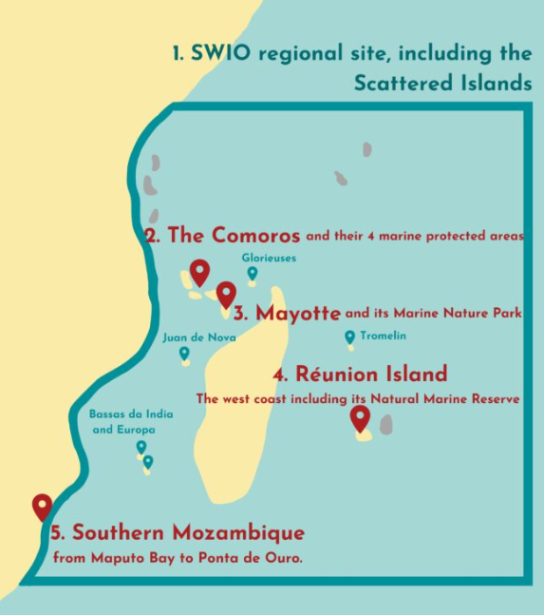
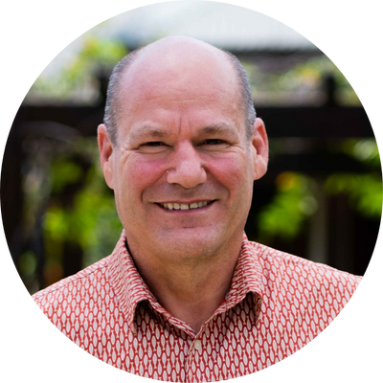
A case study approach
The SWIO Food Island Systems : Overview and key sustainability challenges
Prof Edward H. Allison
Expert on aquatic food systems, fisheries, and coastal livelihoods
Principal Scientist at WorldFish
Penang
BRIDGES OCEAN TALKS#3: 13th July 2026 from 1pm to 1:45pm (UTC +4)

