Slide 1

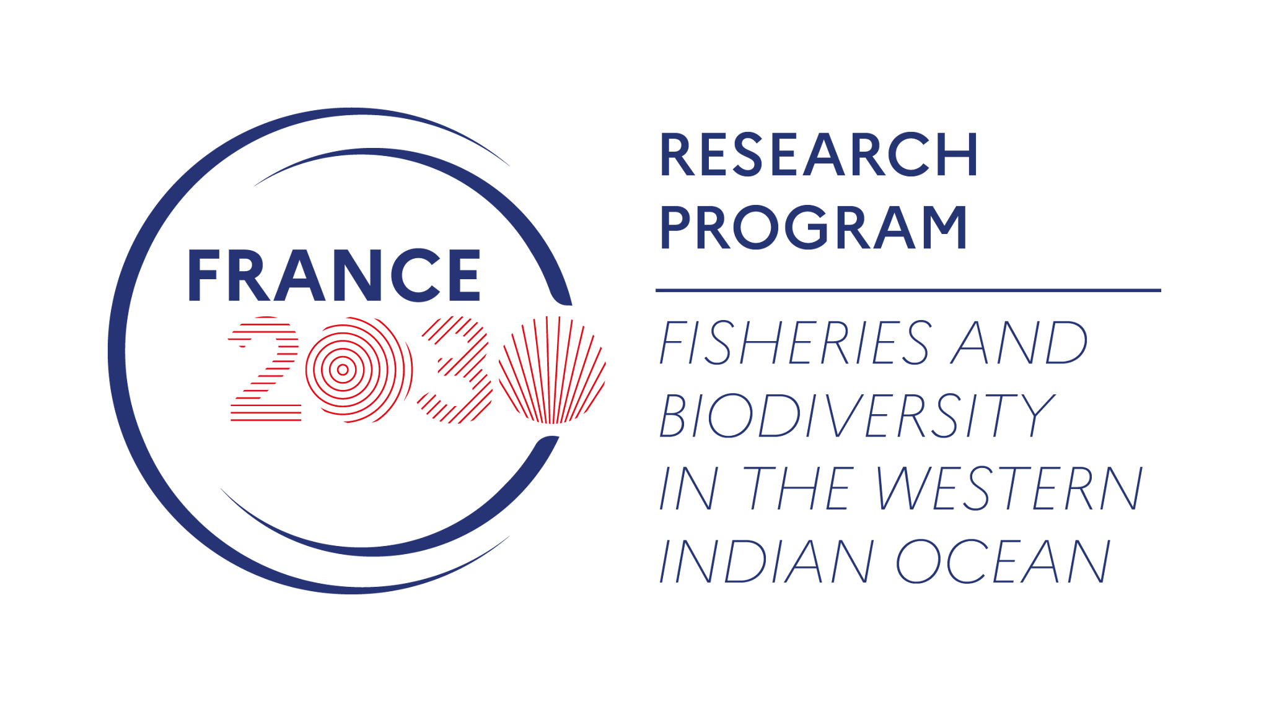






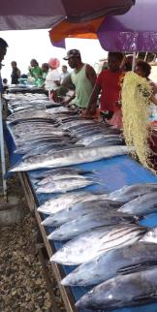
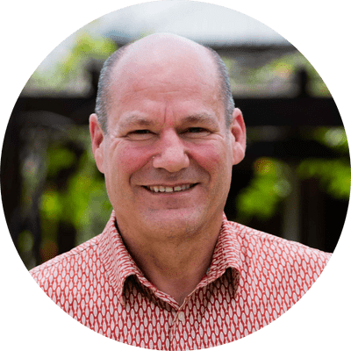

A Pacific and Timor Leste case studies approach
Pacific Island Food Systems : overview and reflections for the SWIO region
Prof Edward H. Allison
Expert on aquatic food systems, fisheries, and coastal livelihoods
Principal Scientist at WorldFish
Penang
BRIDGES OCEAN TALKS#3: 13th July 2026 from 1pm to 1:45pm (UTC +4)

Slide 2
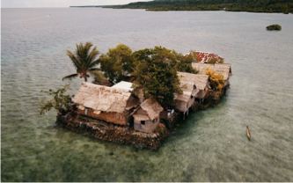
Island Food Systems Characteristics
Land and water scarcity
Vulnerable to climate change and natural disasters
Frequently deficient in domestic food production
Often ocean dominated; aquatic foods play a central role
Distance and scale affect trade competitiveness
Relatively small populations and economies
History of colonialism and as ‘plantation economies’
Nutrition trends are consistently poor
Many still have rich Indigenous or locally-adapted practices and foods
Growing collective voice of Small Island Developing States (‘Large Ocean States’) in multilateral organizations - e.g. shaping the global climate change agenda
BRIDGES OCEAN TALKS#3 - 13th July 2026 - 1-1:45pm (UTC +4)

Slide 3
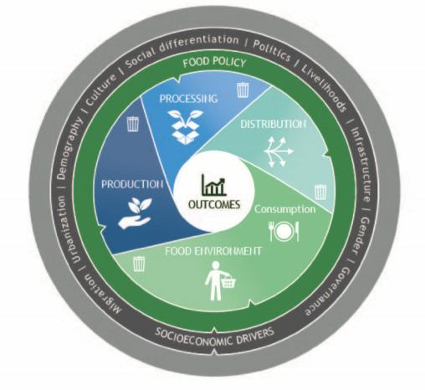
An Island Food Systems Framework
The lighter grey (outside) band represents external biophysical drivers: e.g. ocean temperature change, sea level rise, ocean acidification,
The food system has four components, encompassing the chain from production to consumption
Outcomes can be assessed in terms of nutrition and health, environmental impacts, economic contributions etc.
Source: Andrew et al. (2022). Continuity and change in the contemporary Pacific food system. Global Food Security 32
BRIDGES OCEAN TALKS#3 - 13th July 2026 - 1-1:45pm (UTC +4)

Slide 4
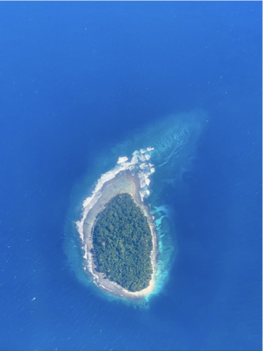
Why a specific Island Food Systems Approach?
Islands face particular challenges of biogeography, political and economic history.
Most agronomic innovation is designed to scale in large continental agroecosystems (e.g. rice-based systems in Asia, Maize-based systems in sub-Saharan Africa).
Small populations and ‘minor’ crops are excluded from agrifood research and technological innovation
Aquatic foods, important to Island populations, are often forgotten.
Mainstream models for sustainability transitions rely on economies of scale and global market integration
BRIDGES OCEAN TALKS#3 - 13th July 2026 - 1-1:45pm (UTC +4)

Slide 5
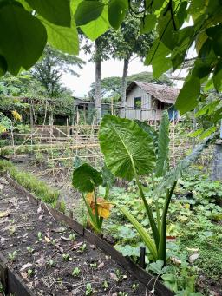
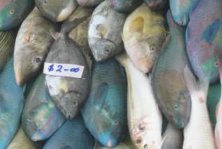
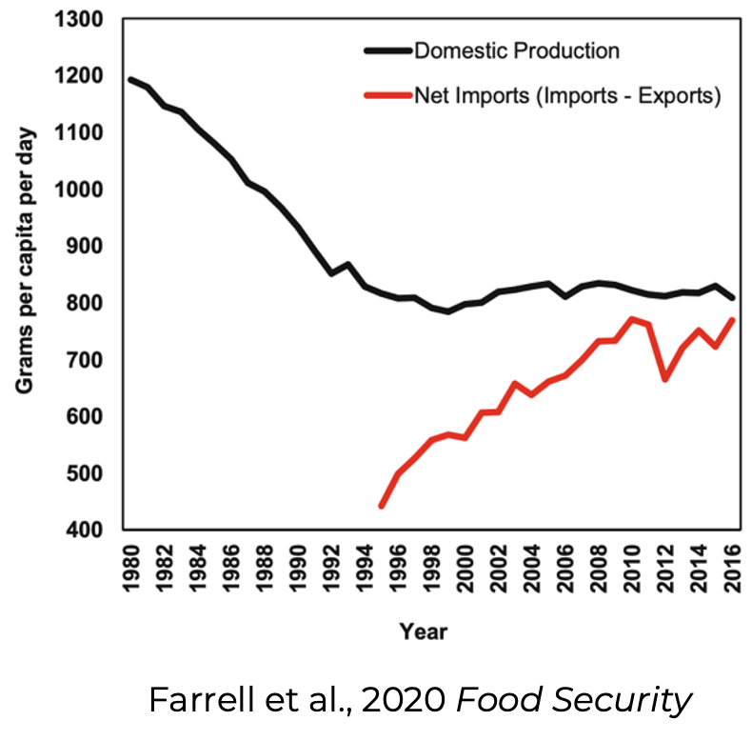
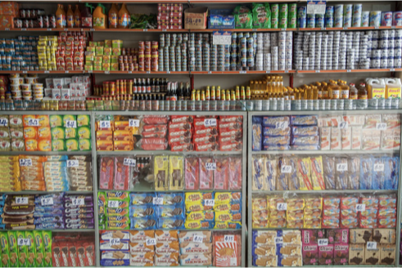
Globalization Impacts: falling domestic food production and rising food imports
BRIDGES OCEAN TALKS#3 - 13th July 2026 - 1-1:45pm (UTC +4)

Slide 6
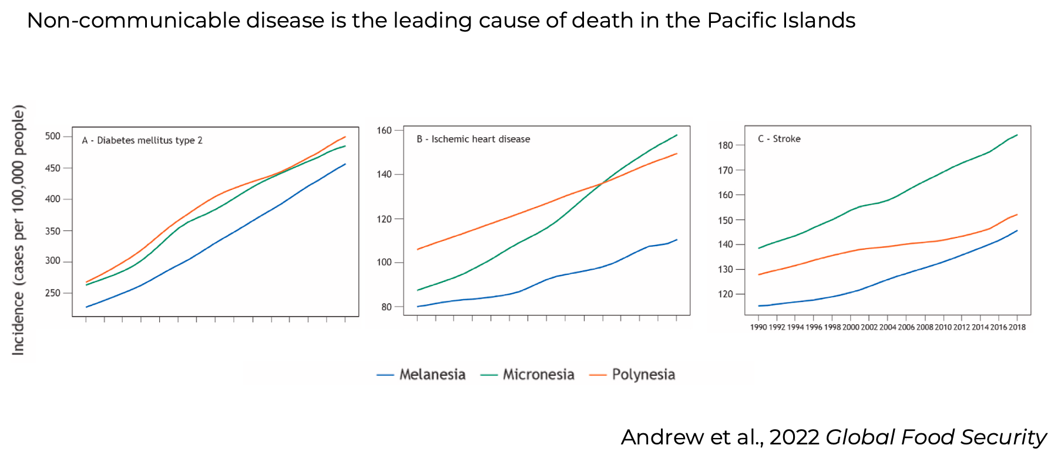
Nutrition and Health Outcomes
BRIDGES OCEAN TALKS#3 - 13th July 2026 - 1-1:45pm (UTC +4)

Slide 7
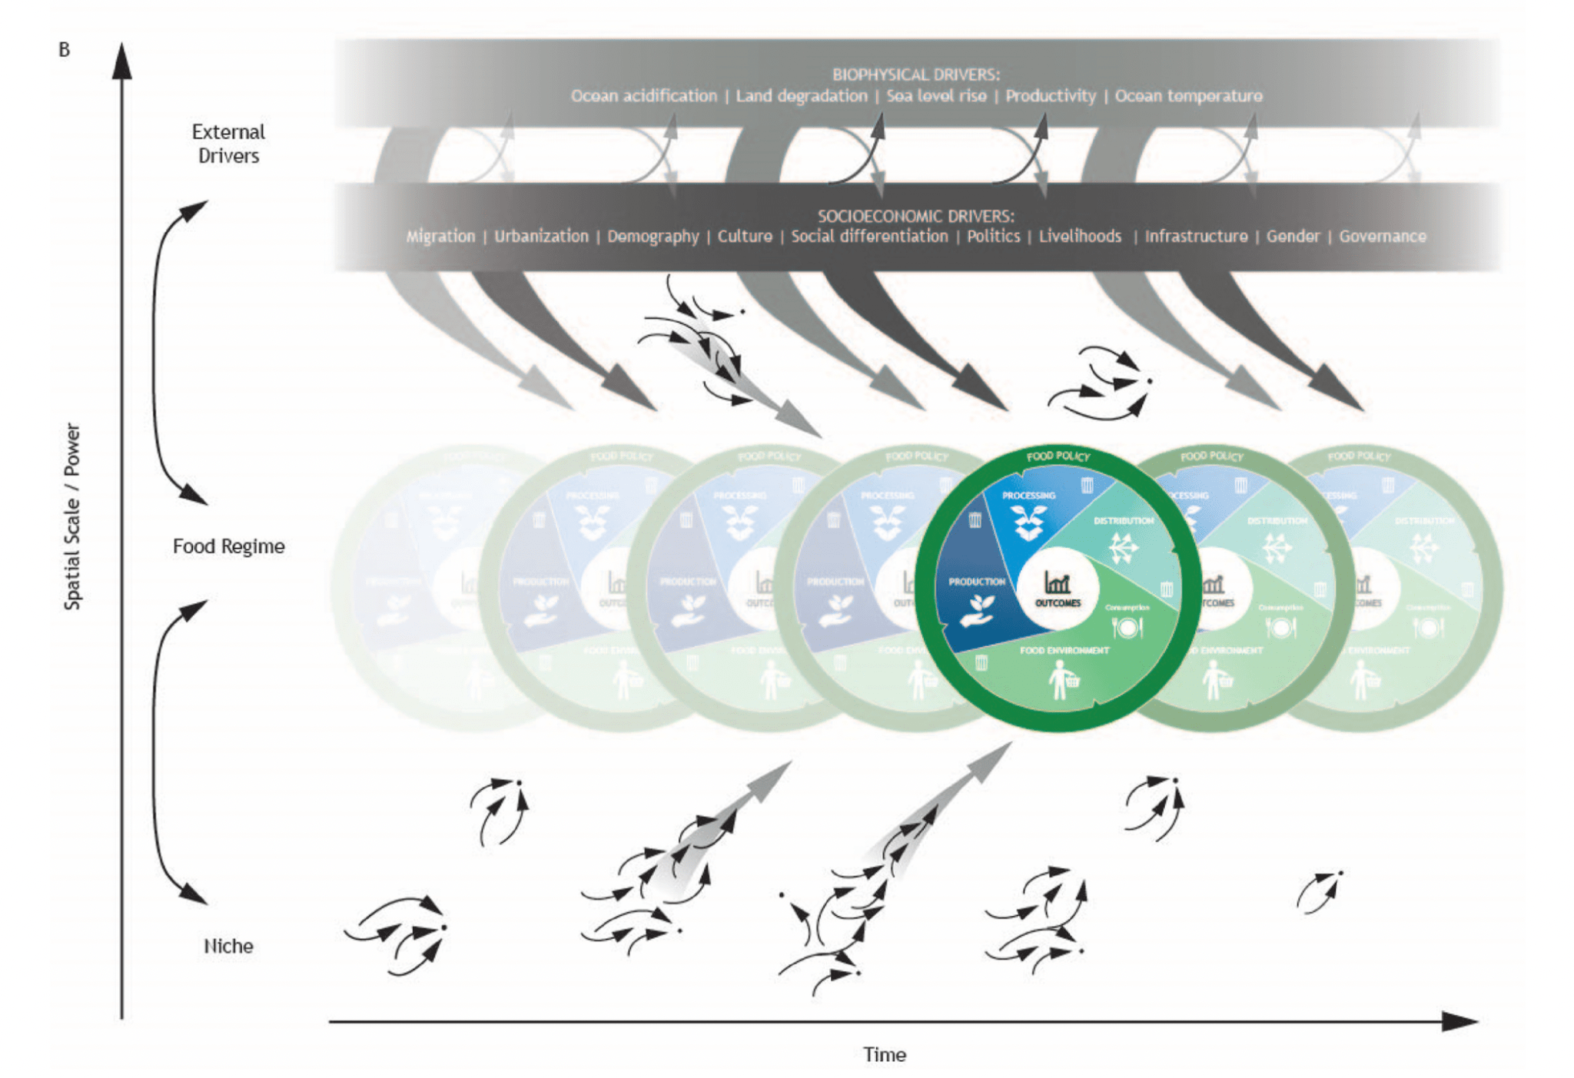
Innovation processes to transform island food regimes
Food regimes are persistent states that determine the structure and outcomes of a food system.
An agri-industrial food regime dominates world agriculture, with negative health, livelihood and environmental consequences
Transformation can occur when ‘niche innovations’ scale to alter the regime, or when external drivers force transformation
Transformations can be planned and positive, or reactive and negative
BRIDGES OCEAN TALKS#3 - 13th July 2026 - 1-1:45pm (UTC +4)
Andrew et al., 2022. Global Food Security

Slide 8
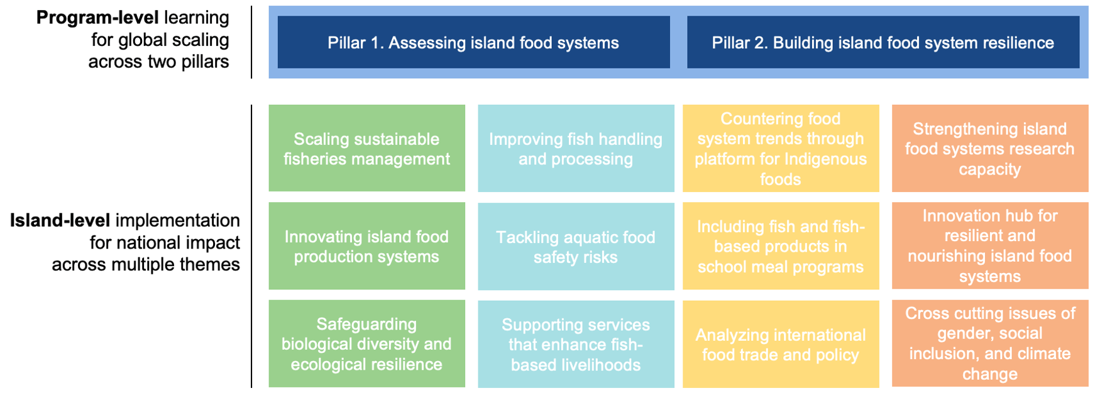
A Research-for-Development Program in Island Food Systems
Currently focused on Solomon Islands (and wider Western Pacific) and Timor Leste
Future collaboration with BRIDGES in WIO and with CGIAR centers in the Caribbean?
BRIDGES OCEAN TALKS#3 - 13th July 2026 - 1-1:45pm (UTC +4)

Slide 9
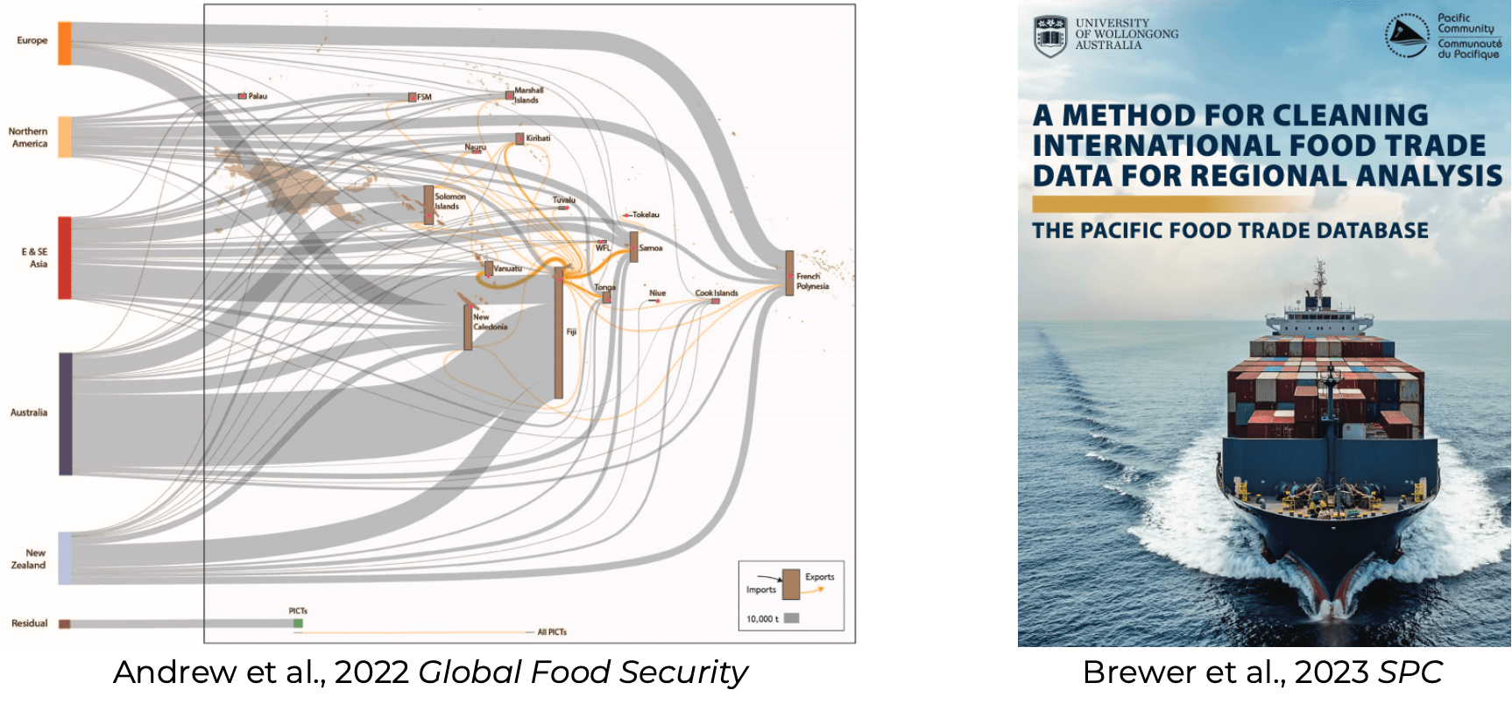
Food trade and its role in shaping food systems and their health outcomes
BRIDGES OCEAN TALKS#3 - 13th July 2026 - 1-1:45pm (UTC +4)

Slide 10
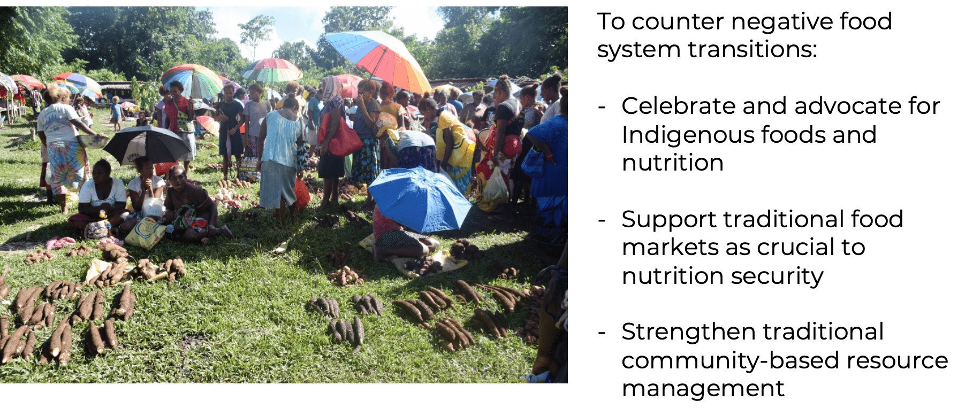
Recognize “social platforms” supporting food systems - Solomon Islands
BRIDGES OCEAN TALKS#3 - 13th July 2026 - 1-1:45pm (UTC +4)

Slide 11
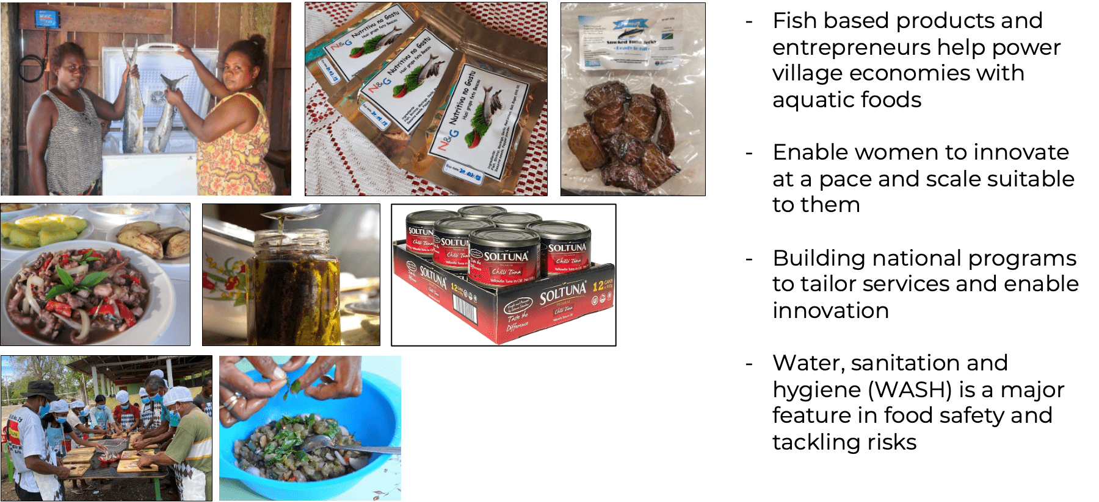
Improve food safety, fish handling and processing
BRIDGES OCEAN TALKS#3 - 13th July 2026 - 1-1:45pm (UTC +4)

Slide 12
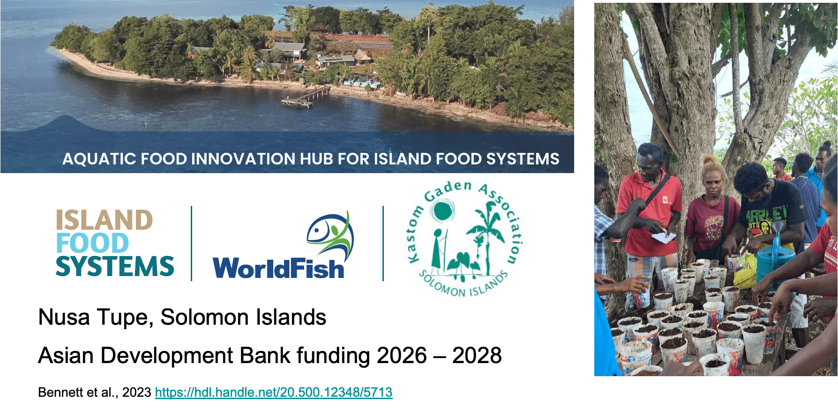
Training the next generation of Island Food System leaders - SI
BRIDGES OCEAN TALKS#3 - 13th July 2026 - 1-1:45pm (UTC +4)

Slide 13
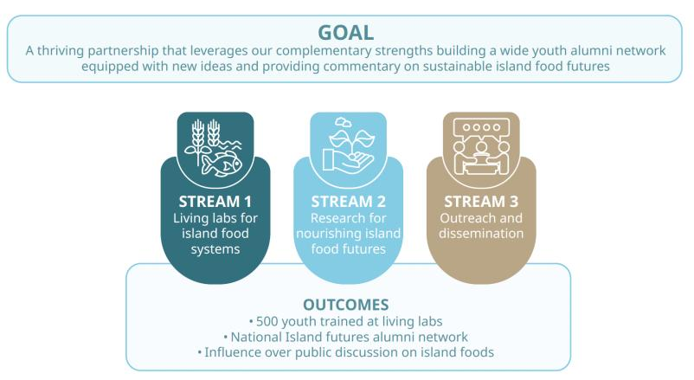
Build durable strategic partnerships and capacity-sharing models
Solomon Island National University
Centre for Island Futures
and
WorldFish, Solomon Islands
BRIDGES OCEAN TALKS#3 - 13th July 2026 - 1-1:45pm (UTC +4)

Slide 14
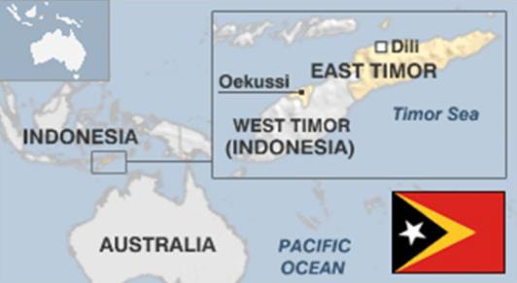
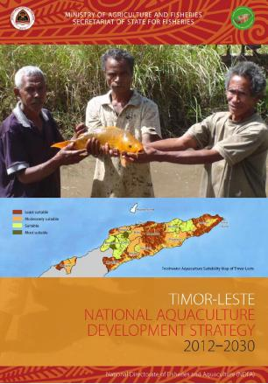
Work in partnership with Government to
implement evidence-based policy - Timor Leste
Timor Leste Partnerships for Aquaculture Development Project, 2015-2026
Funded by New Zealand MFAT (+ USAID)
Jharendu Pant et al, 2024; 2026
BRIDGES OCEAN TALKS#3 - 13th July 2026 - 1-1:45pm (UTC +4)

Slide 15
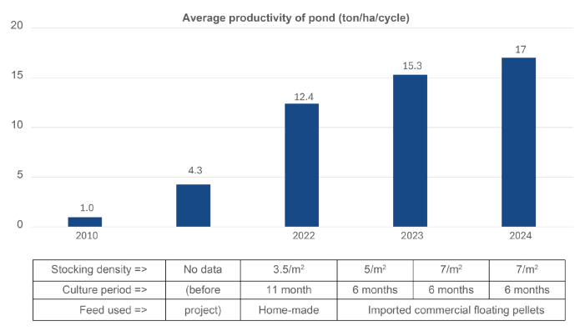
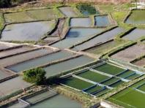
Timor Leste Partnerships for Aquaculture Development Project, 2015-2026
Public-Private-Community Partnership to develop aquaculture
Sustainable intensification: GIFT Tilapia, Improved feeds, optimal stocking rates
Productivity per cycle increased, and shift from one to two harvest cycles per year
Jharendu Pant et al, 2024; 2026
BRIDGES OCEAN TALKS#3 - 13th July 2026 - 1-1:45pm (UTC +4)

Slide 16
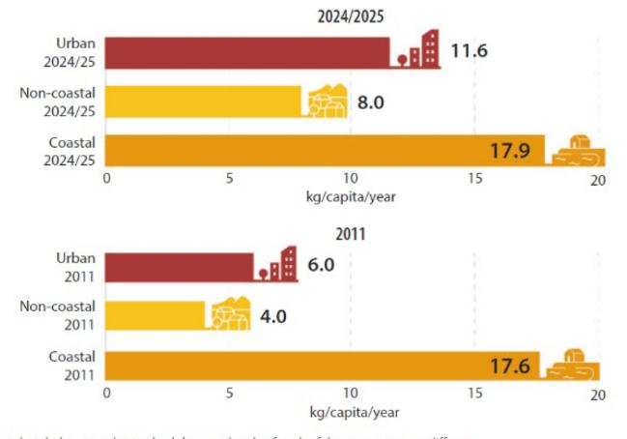
Timor Leste Partnerships for Aquaculture Development Project, 2015-2026
Challenge: 47.1% children under 5 are stunted; 23% of women aged 15-49 are affected by anaemia
Policy goal: Improve access to nutrient dense foods, including aquatic foods
Policy target: Increase national per capita fish consumption from 6.1 kg (2010) to 15.0 kg (2030).
Jharendu Pant et al, 2024; 2026
BRIDGES OCEAN TALKS#3 - 13th July 2026 - 1-1:45pm (UTC +4)

Slide 17
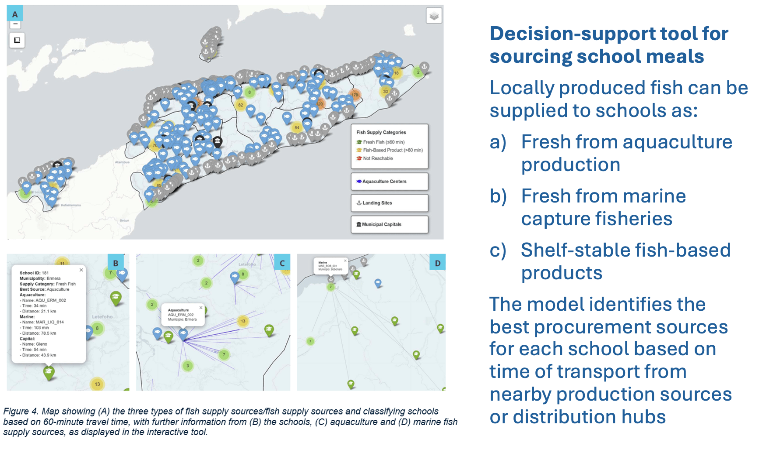
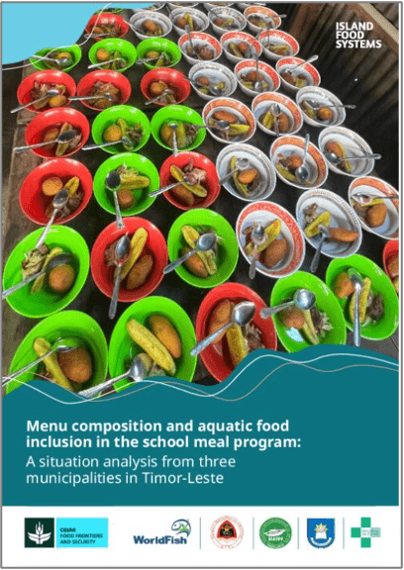
School Feeding Programs: Timor Leste
BRIDGES OCEAN TALKS#3 - 13th July 2026 - 1-1:45pm (UTC +4)

Slide 18
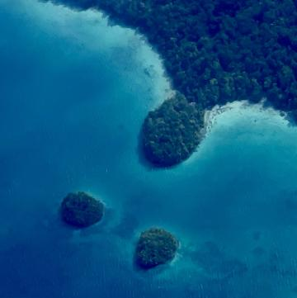
Summary
Island Food Systems have sufficient distinct and shared characteristics to merit a special study and development strategy
Transition to imported, processed, unhealthy diets has been disastrous for island populations’ health
Sustainability transitions are possible by building on Indigenous and customary practice and modern advances in agronomy and aquaculture, while dismantling the remaining legacies of plantation economies and strengthening food sovereignty.
Practical projects, led by island communities and institutions, are needed to bridge concepts, technologies and policies and implement sustainable practices at scale
BRIDGES OCEAN TALKS#3 - 13th July 2026 - 1-1:45pm (UTC +4)

Slide 19
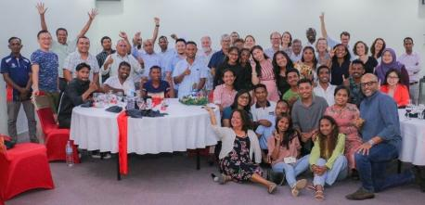
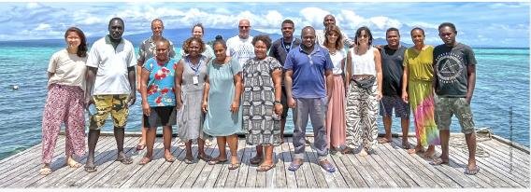
Thank you
Solomon Islands
Timor Leste
More information:
https://www.worldfishcenter.org/island-food-systems
BRIDGES OCEAN TALKS#3: 13th July 2026 from 1pm to 1:45pm (UTC +4)

